Slide 1
Des Encryption
Babikr Elnimah 20124005
Mohammed Amman Sheik 201205380
Ahmed Hamdy Ibrahim 201204361

Slide 2
Contents
The History of DES Encryption
How Does DES Encryption Work?
Cracks that Defeated DES
How Future Encryptions Standards Avoided The Cracks

Slide 3

A History of DES
For a period of time, as of not long ago DES (Data Encryption Algorithm) was the primary encryption algorithm for encrypting data.
DES is a product of a research project ran by IBM (International Business Machines) in the late 1960’s
This research eventually lead to the creation of a encryption cipher known as LUCIFER
In the early 1970’s IBM decided to commercialize
LUCIFER

Slide 4


LUCIFER
The commercialization of LUCIFER resulted in a large number of adjustments
These changes were not done entirely by IBM alone
A number of outside consultants were recruited by IBM
However the major contributor in terms of technical
contribution was the NSA
The resulting altered version of LUCIFER was proposed to the NBS (National Broad of Standards) as an answer to their call for a new national encryption standard.

Slide 5


In 1977 the altered version of LUCIFER was dubbed DATA ENCRYPTION STANDARD – DES (FIBS PUBS 46) and adopted by NBS as its name sake

Slide 6
How Does DES Encryption Work?
DES is a 64-bit block cipher (It encrypts 64-bit blocks of data to produce a corresponding 64-bit block of CT)
DES uses a 64-bit key
However every 8th bit of the key is ignored so in actuality only 56-bits of the key are used

Slide 7

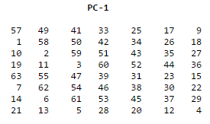
More Details
DES takes the 64-bit block of PT and divides it into 2 32-bits side L (left) & R (right)
Next the 64-bit key to create sub keys that will used to eventually encrypt the PT
Step 1: The original key (K = 64bits) is rearranged according to a permutation matrix to create a permuted key (K+=56bits)

Slide 8

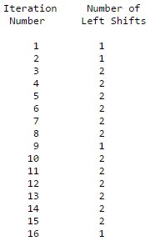
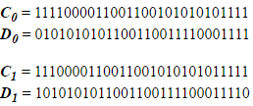
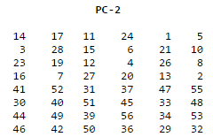
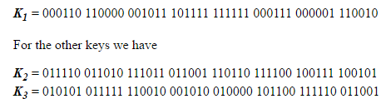
More Details
Next K+ is divided into two halves C0 and D0
After which 16 blocks of Cn and Dn are formed using a using a schedule to alter the number of shifts to left of both Cn-1 and Dn-1
However, the last bit is cycled to become the first bit
This means, for example, C₃ and D₃ are obtained from C₂ and D₂, respectively, by two left shifts
At long last the subkey’s Kn can now be created by using a permutation table similar to the one the previous slide however this time using the CnDn pairs and going from 56 bits to 48 bits

